Slide 1
Poverty, Progress and Puzzles in African Agriculture
Christopher B. Barrett, Cornell University
Global Food + 2017 Event
Harvard University
February 24, 2017

Slide 2
7/14 world’s fastest growing economies are in Africa and agriculture is at the heart of much of that growth
Annual average real GDP growth, 2010-15. Data source: World Bank

Slide 3
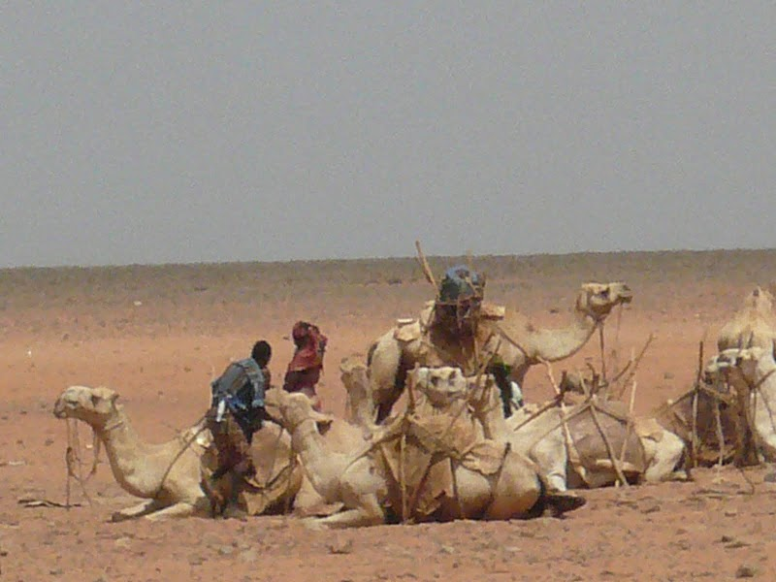
Yet deep poverty and great heterogeneity among households/regions. - SSA had 17% of world’s ultra-poor (≤$0.95/day pc) in 1987. increased to 57% in 2011 as grew from 200 mn to 298 mn

Slide 4
So what’s going on? Several key puzzles:
1. Those primarily employed in agriculture work far fewer hours per year than those primarily employed outside ag …
Source: McCullough, Food Policy 2016
Notes:
Sou

Slide 5
This matters because what appears as a big inter-sectoral difference in average labor productivity per worker per year …
Source: McCullough, Food Policy 2016
Notes:
Sou

Slide 6
Essentially vanish when we examine inter-sectoral difference in average labor productivity per worker-hour …
So are ‘productivity gaps’ actually employment gaps?
perhaps … we know inter-sectoral productivity gaps are large, too
Source: McCullough, Food Policy 2016
Notes:
Sou

Slide 7
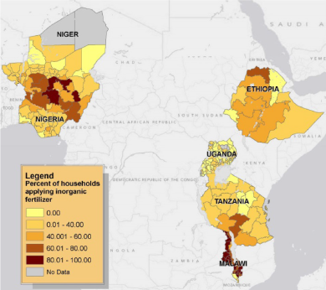
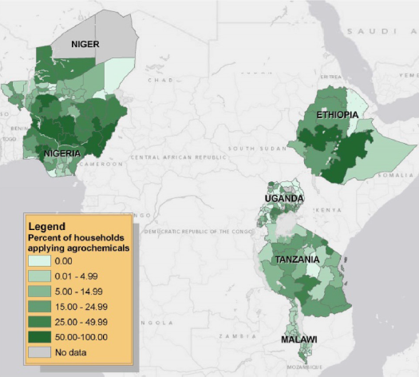
2. Heterogeneous uptake of innovations
LSMS-ISA data show that uptake of modern ag inputs varies markedly, both within and among countries. (Sheahan & Barrett, FP in press)

Slide 8
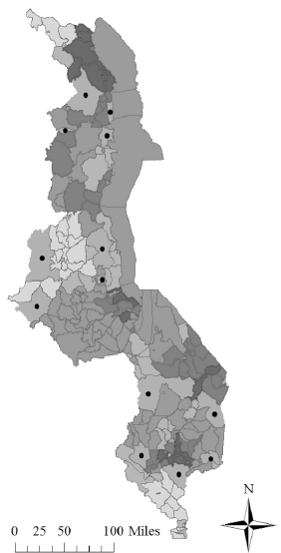
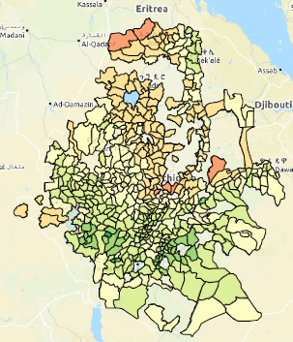
Likely reflects heterogeneous returns due to variation in soils, weather, prices …
Probably relatedly, a number of recent studies find spatially heterogeneous returns to inputs:
Suri (EMTRA 2011) – Kenya hybrid maize seed
McCullough et al. (WP 2016) - Ethiopia fertilizer
Burke et al. (AgEcon 2016) -
Zambia fertilizer
Harou et al. (JAfrEcon in press) - Malawi fertilizer
.
https://www.ag-analytics.org/AgRiskManagement/EthiopiaGeoApp

Slide 9
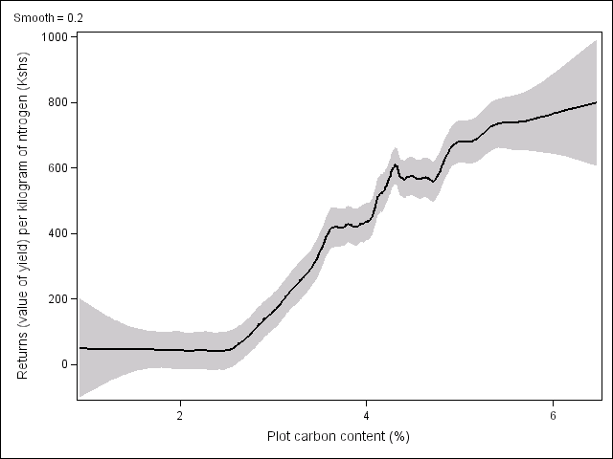
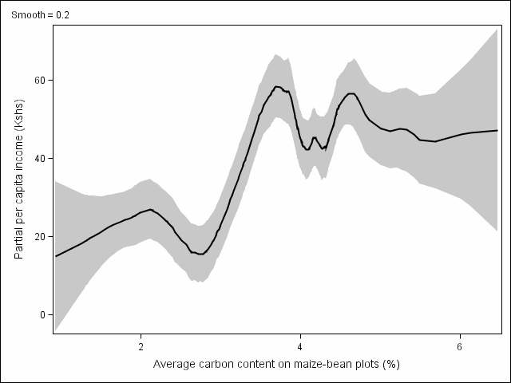
Can help explain apparent poverty traps
Example: Soil degradation in Kenya Marginal returns to fertilizer application low on degraded soils; and poorest farmers are on the most degraded soils.
Above red line: fertilizer profitable
Value of maize from 1 kg of nitrogen
Cost of 1kg nitrogen
Kenyan rural poverty line
Below red line: fertilizer unprofitable
Marenya & Barrett AJAE 2009

Slide 10
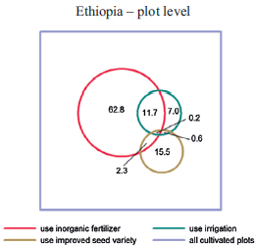
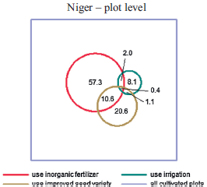
3. Uneven adoption even within hhs
Example: Limited joint input application
LSMS-ISA data show little joint uptake of modern ag inputs despite agronomic synergies and contrary to ISFM principles.
(Sheahan & Barrett, FP in press)

Slide 11
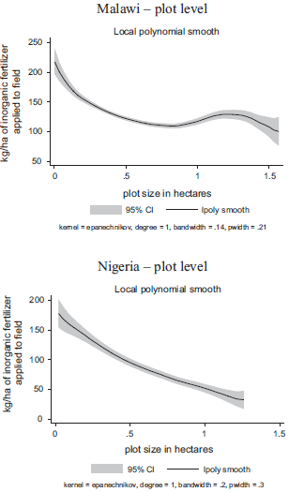
Plot-level inverse size-productivity relation
Plot-level input application and productivity varies inversely w/plot size. True within-hh and w/controls for soil quality and actual size, so not due to ORV, measurement error, or heterogeneous shadow prices.
Adoption varies even across plots w/n hh … why? Edge effects hypothesis?
(Barrett, Bellemare & Hou WD 2010; Carletto, Savastano & Zezza JDE 2013; Sheahan & Barrett, FP in press; Bevis & Barrett, 2016 WP)

Slide 12
Resolution of these (and other) puzzles can help promote more inclusive growth and faster reduction of poverty and food insecurity.
Thank you for your interest and comments!

